Slide 1
Detection of Gender, Age and Emotion of a Human Image Using Facial Features
Supervisor: Prof. Mimi Cherian
Submitted By:
Dipesh Nair
Gautam Nair
Anoop Pillai
Sidharth Nair

Slide 2
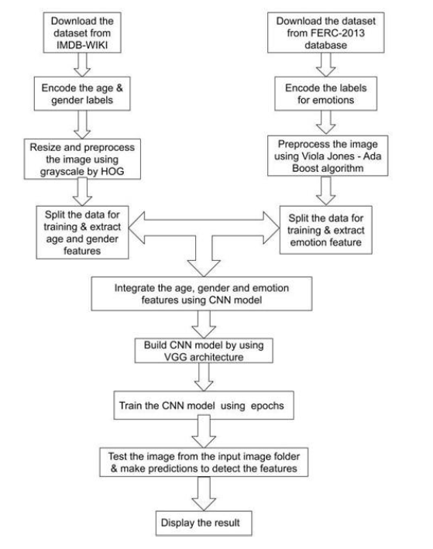
Architecture

Slide 3
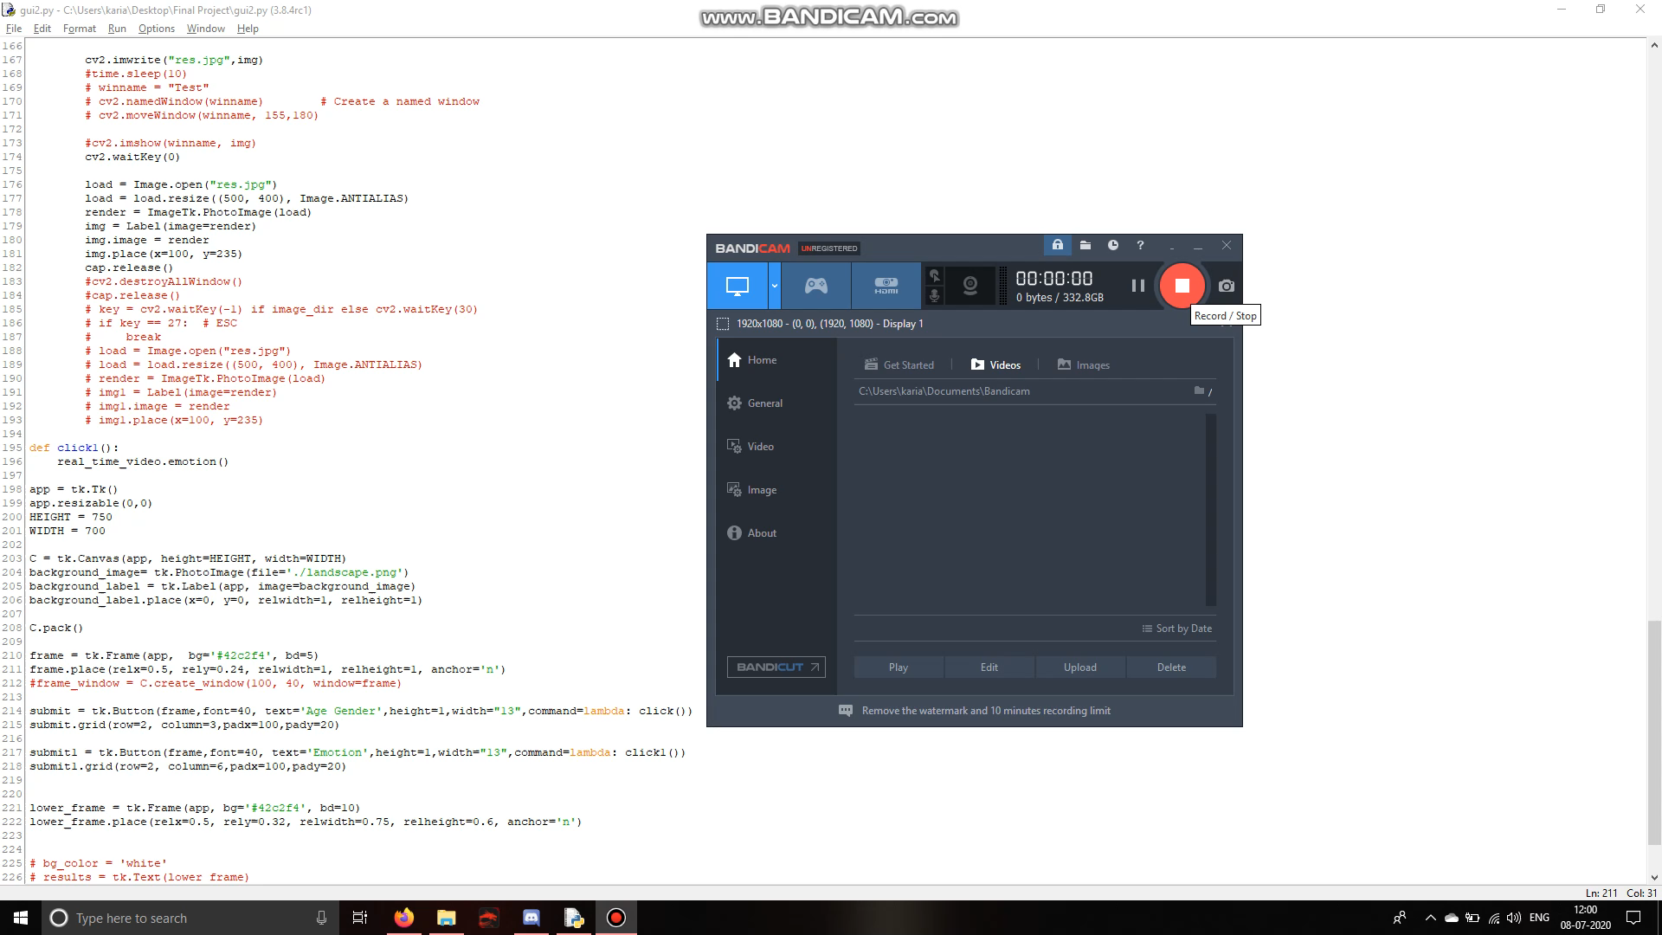
Result

Slide 4
Thank You

